Slide 1
Synthetic Image Detection (SID)
Stratos Kakalis
Fotis Vorloou

Slide 2
Introduction to Synthetic Image Detection (SID)
AI-generated content becomes more photorealistic
Ensuring the authenticity of visual data is crucial
Developing reliable techniques to differentiate real and synthetic images is essential

Slide 3
Architectures we implemented for this cause:
Convolutional Neural Networks (CNNs)
the AIDE model
Vision-Language Models(VLMs)

Slide 4
Dataset and Benchmarks
Artifact Dataset
Training
Fine-Tuning
Chameleon Dataset
Benchmark

Slide 5
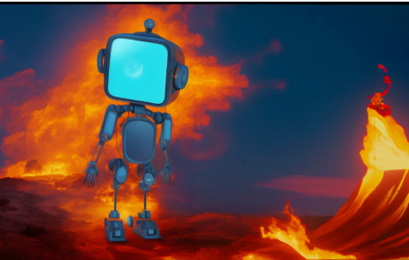
The Artifact Dataset
A large-scale dataset designed specifically for AI-generated image detection. It consists of millions of real and synthetic images sourced from a variety of datasets. It provides a comprehensive benchmark for training and evaluating AI-generated image detection models.

Slide 6
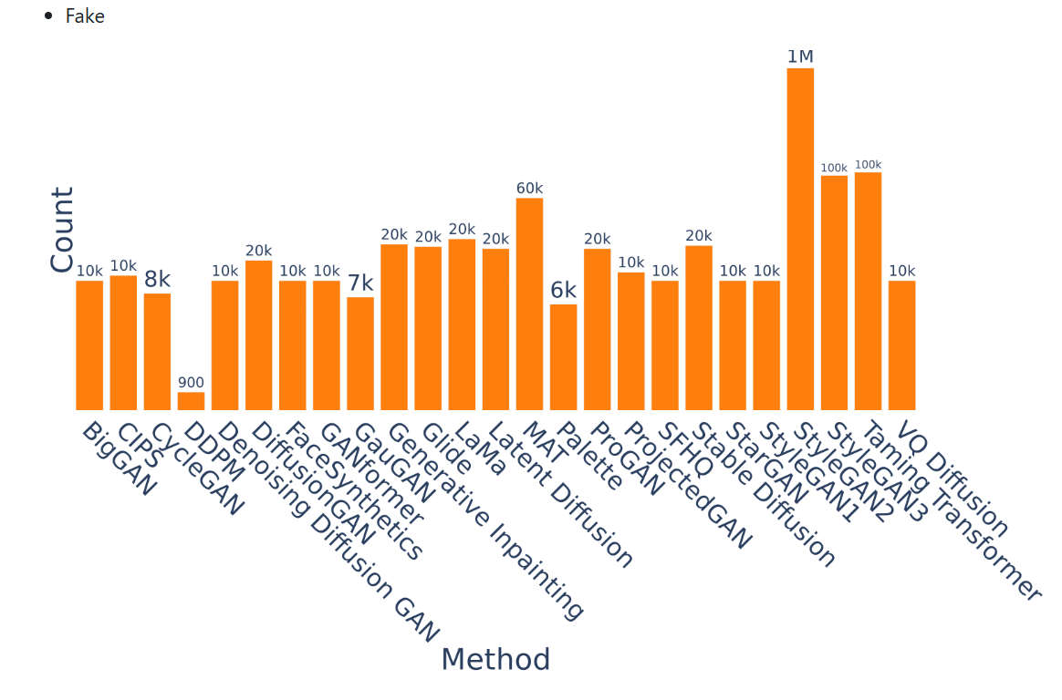
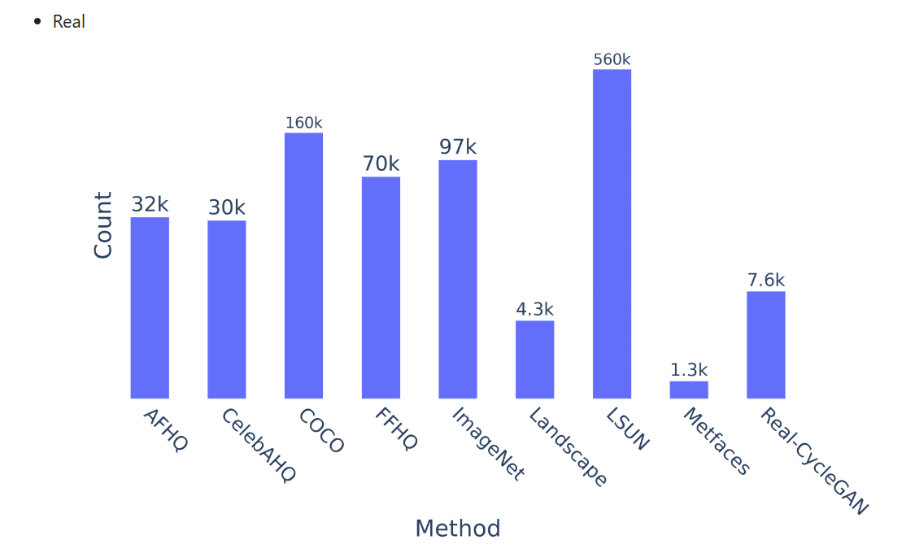
Artifact Dataset Data Distribution

Slide 7
The Artifact-Splits Subset
The Artifact-Splits dataset includes three key partitions:
• train metadata.csv (default: 100,000 images after downsampling)
• val metadata.csv (default: 10,000 images after downsampling)
• test metadata.csv (default: 10,000 images after downsampling)
Each metadata file contains:
• filename: The name of the image file.
• image path: The relative path to the image within the dataset.
• target: The label indicating whether the image is real (0) or synthetic(1).
• category: The category of the image (e.g., FFHQ, LSUN, StyleGAN,COCO).

Slide 8
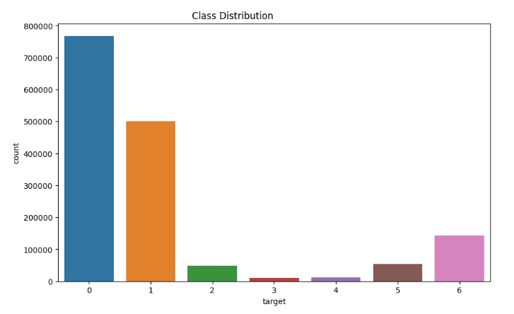
Balanced Downsampling
Subsets that preserve dataset balance while maintaining a manageable size.
•There is an equal representation of real and synthetic images in the dataset.
• The model does not become biased toward real or synthetic images.
• The dataset remains diverse across different synthetic image generation techniques.

Slide 9
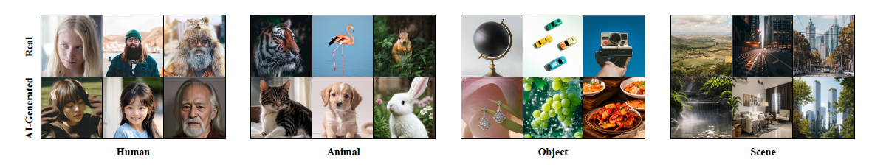
The Chameleon Dataset
A challenging benchmark specifically designed for evaluating AI-generated image detection models. Unlike traditional benchmarks, Chameleon focuses on images that are highly deceptive to human perception, meaning many AI-generated images in this dataset have passed a human Turing Test. Given its high adversarial difficulty, it is an ideal test for models aimed at detecting next-generation synthetic media.

Slide 10
The AIDE (AI-generated Image Detection) Model
An deep-learning-based framework designed for detecting AI-generated images that distinguishes between real and synthetic images by utilizing a frequency-based analysis approach combined with deep feature extraction to improve detection robustness.

Slide 11
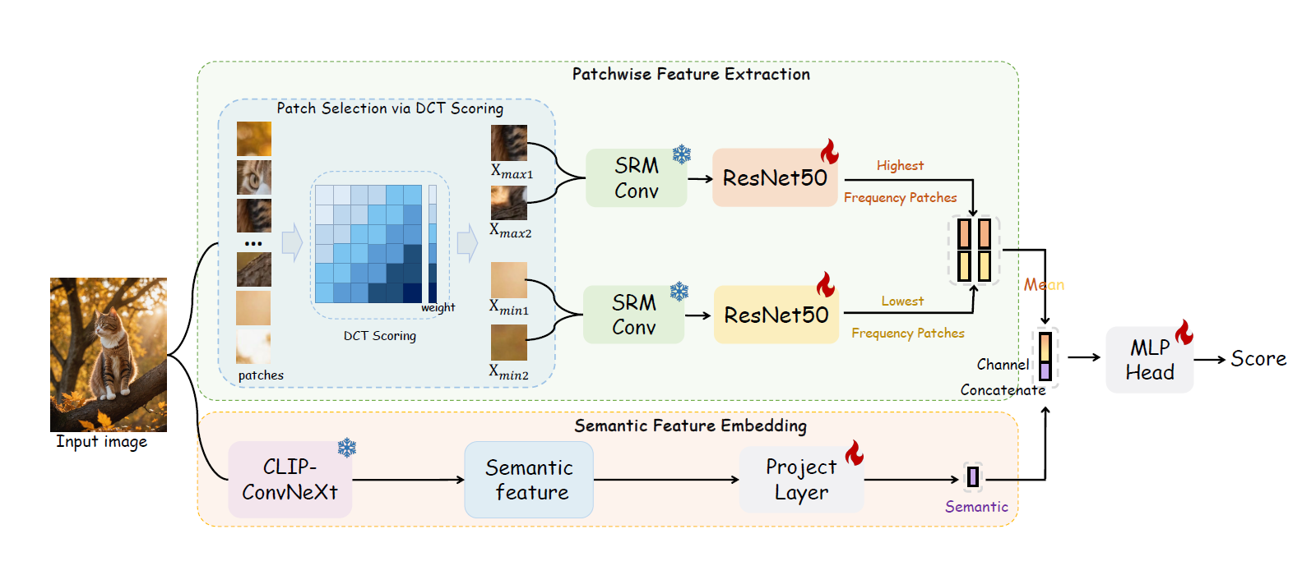
AIDE Architecture

Slide 12
AIDE Architecture
Architecture / Technique Used
Component
High-Frequency Analysis
Patch-Based Processing
Frequency Features
Semantic Features
Feature Fusion
Classifier
Optimizer
DCT + SRM Filters
Image Unfolding + Top-k Selection
ResNet-50 (2048-dim)
ConvNeXt-XXLarge (1000-dim)
Concatenation (4096-dim)
Fully Connected (512 → 2)
Adam (Best)

Slide 13
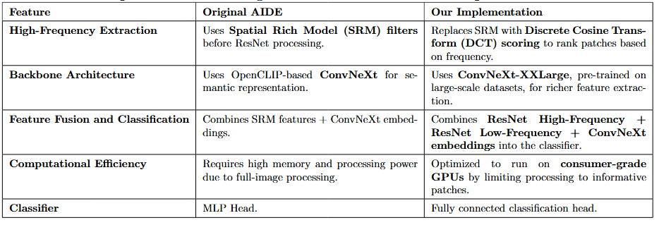
Our Implementation

Slide 14
Challenges Faced
High Memory Requirements: ConvNeXt-XXLarge is a computation-ally expensive model. We reduced batch sizes and optimized GPU memory allocation.
• Overfitting on Small Datasets: Initially, the model overfitted to the training set. We introduced data augmentation and dropout layers to improve generalization.
• Slow Training Time: Using ConvNeXt required significant training time. We implemented multi-thread training and efficient batch loading to speed up training.

Slide 15

Fine-Tuning
After Fine-Tuning our model ended up with:
Adam Optimizer
ConvNeXt-XXLarge
StepLR scheduler
dropout (0.1)
Lr=1e-4

Slide 16
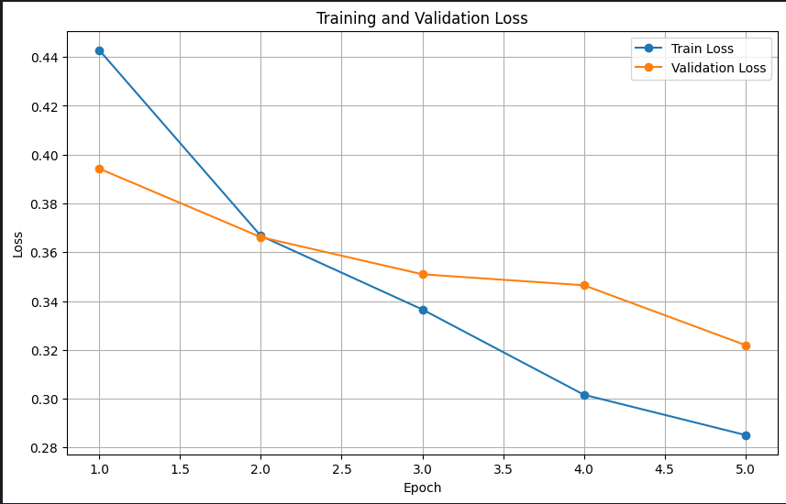
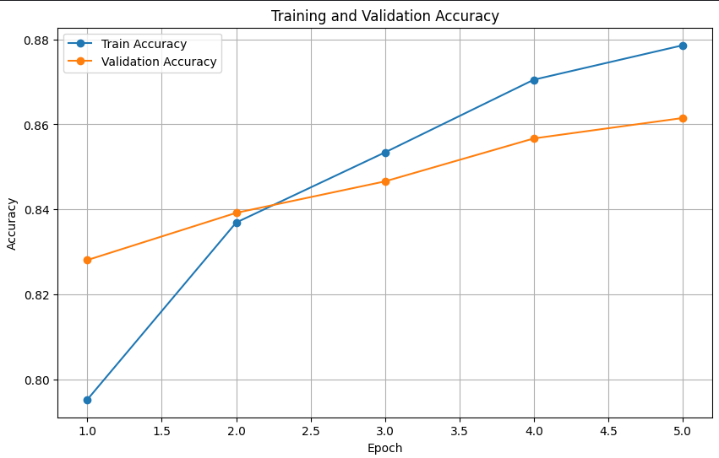
Training
Our optimized AIDE with ConvNeXt-XXLarge achieved:
• 87.8% training accuracy .
• 86.1% validation accuracy
• 28.5% training loss
• 32.2% validation loss

Slide 17
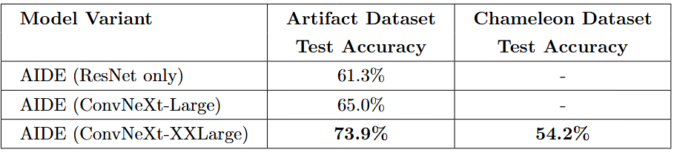
Performance Analysis
The model was trained on 100k images of the Artifact dataset and it was tested on 10k images of the Artifact dataset and 26k images of Chameleon Dataset

Slide 18
Observations and Analysis
• Improvement with ConvNeXt: The use of ConvNeXt-based architectures significantly boosts performance over the original ResNet-based AIDE implementation. On the Artifact Dataset, switching from ResNet to ConvNeXt-XXLarge improves test accuracy from 61.3% to 73.9%.
• Challenges with Chameleon Dataset: Despite strong results on the Artifact dataset, the Chameleon dataset remains a significant challenge. Even the best-performing model (AIDE with ConvNeXt-XXLarge) only achieves 54.2% accuracy, showing that high-quality synthetic images generated by Chameleon are far harder to distinguish.
• High Bias Toward Real Images: The model performs well in detecting real images but struggles significantly with fake images in the Chameleon dataset, achieving only 6% recall for fake images. This indicates a tendency to misclassify synthetic images as real.

Slide 19
Future Work
• Fine-tuning the model on the Chameleon dataset to improve generalization.
• Exploring transformer-based architectures such as Vision Transformers or multimodal models like CLIP.
• Experimenting with adversarial training techniques to expose the model to harder-to-detect synthetic images.

Slide 20
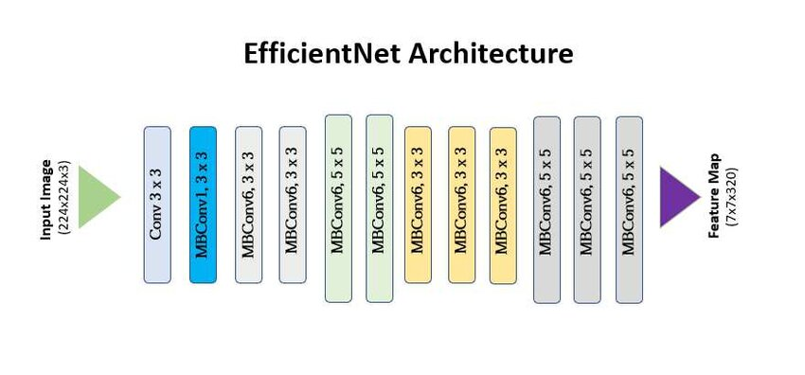
CNNs for Synthetic Image Detection:
Classification Head
Linear
ReLU
Batch Norm
Dropout
Linear
Sigmoid

Slide 21
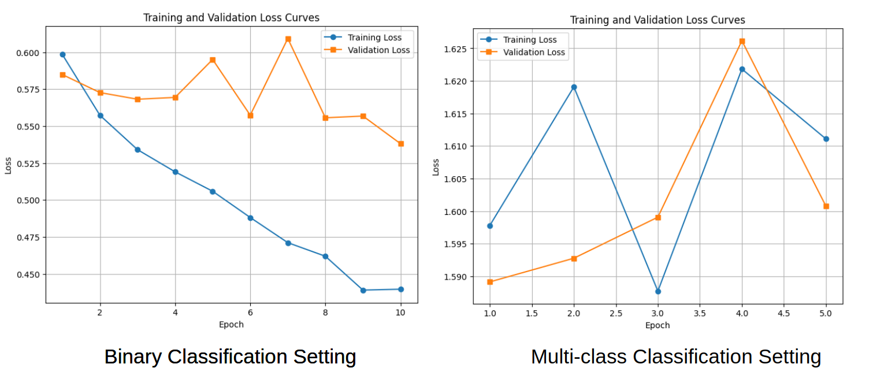
Classification Settings:
Binary Classification Setting: Standard binary classification
Multi-class Classification Setting: Multi-class classification (predicting between 7 labels that specify the generator class) then projected into binary classification (by merging all synthetic predictions into a single class).

Slide 22
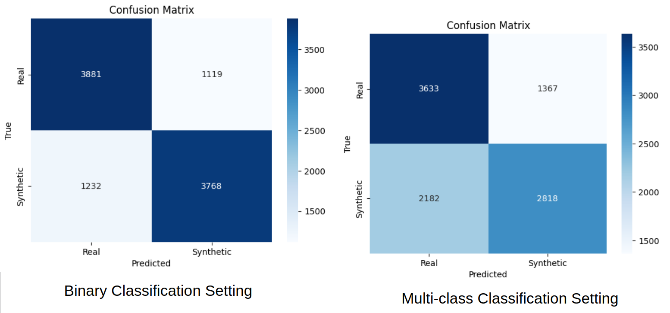
Classification Settings:
Accuracy: 76,5%
Accuracy: 64,5%
Binary Classification Setting: Standard binary classification
Multi-class Classification Setting: Multi-class classification (predicting between 7 labels that specify the generator class) then projected into binary classification (by merging all synthetic predictions into a single class).

Slide 23
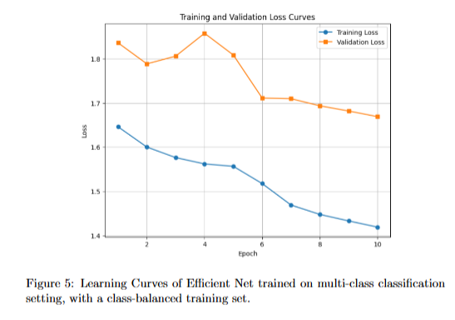
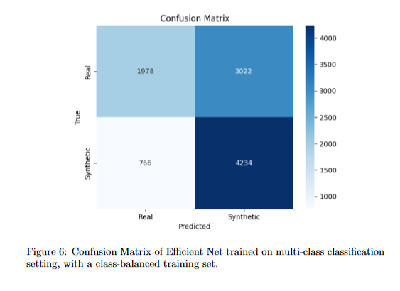
What about Multi-class Classification on a Class-Balanced Dataset?
Accuracy: 62,1%

Slide 24
So does this mean that the multi-class classification setting has no point?
Not necessarily, we simply demonstrate that it doesn’t work for our specific configuration. Additional experiments are needed to verify this method or disprove it.
It could potentially be beneficial if:
We used bigger and more complex models
We had a significantly bigger dataset that was balanced for all classes

Slide 25
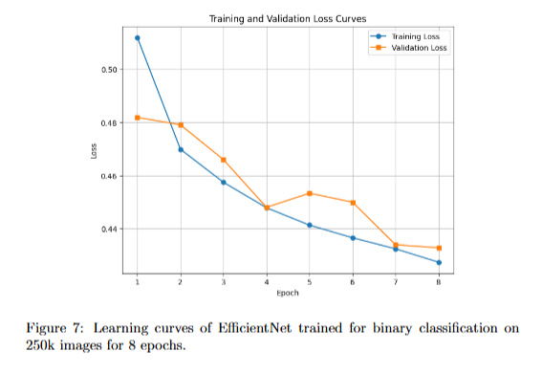
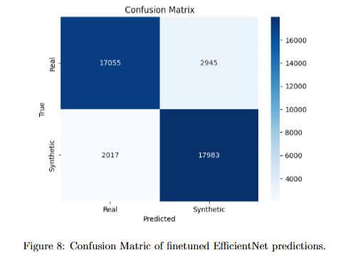
Training our best EfficientNet-based CNN model for SID:
Having learned that a binary classification setting works best, we can train our model on a lot of data to get better results.
We trained our model on 250.000 images for 8 epochs, running for over 5 hours on a P100 GPU.
Accuracy: 87,6%

Slide 26
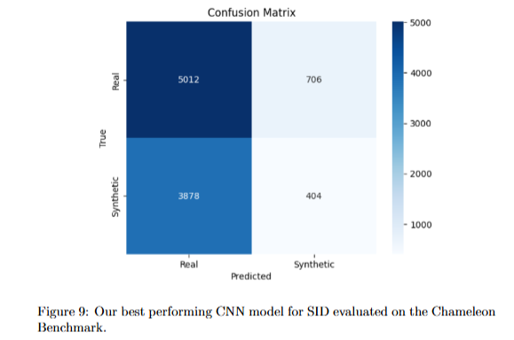
Testing our best-performing model on the Chameleon Benchmark:
Very difficult test: With images that can even trick humans this benchmark is undoubtedly difficult for our models.
Bad generalization: While the model performs really well in our dataset the information is has learned does not transfer well to Chameleon, partly due to its difficulty.
Accuracy: 54,2%

Slide 27
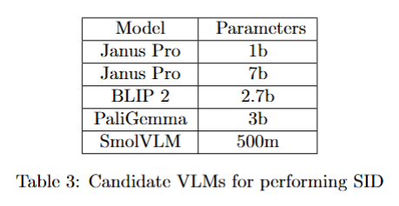
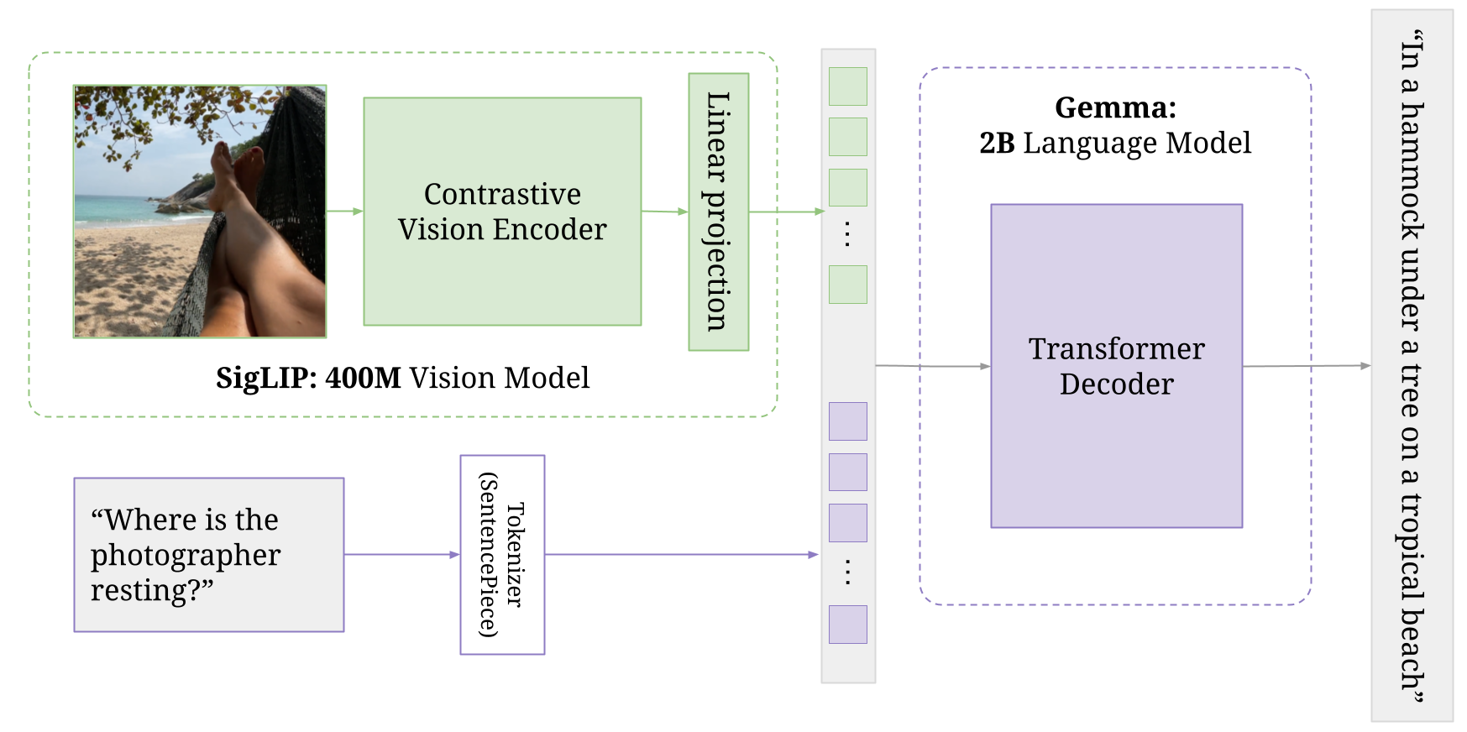
Vision-Language Models for Synthetic Image Detection:
What are VLMs? AI models that process both images and text together.
How do they work? Combine vision (e.g. Transformers) and language models (e.g., LLMs).
Key Applications: Image Captioning, Visual Question Answering.
Why are they important? Enable advanced interactions across multiple domains.
PaliGemma architecture

Slide 28
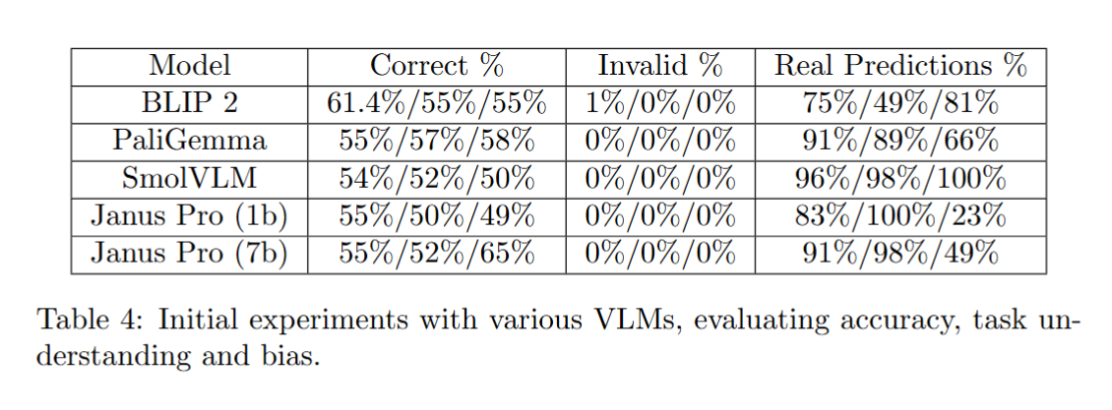
What is the “best” pre-trained VLM for SID?
We evaluate all models on 3 diverse prompts to prevent any single model from benefiting disproportionately due to a prompt that might align particularly well with its training data or internal biases.

Slide 29
Prompt Engineering
List of prompts tested:
Explicit Artifact Detection: Instructs the model to search for irregularities or visual artifacts indicating AI generation.
Confidence-Based Classification: Encourages the model to classify an image as synthetic when uncertain, focusing on small imperfections.
Internal Reasoning: Guides the model to internally analyze image characteristics for real vs. synthetic patterns without generating a reasoning chain.
Comparative Reasoning: Instructs the model to evaluate images by comparing them to known real images rather than identifying absolute features.
Multi-Feature Focus: Expands artifact detection by specifying particular types of imperfections for the model to consider.
Human Perspective: Mimics human perception, emphasizing intuition and common-sense reasoning in classification.
Prompt-engineering is crucial because VLMs rely heavily on textual instructions to guide their reasoning. By carefully structuring our prompts, we can influence how the models analyze images, what features they prioritize, and how they handle uncertainty in classification

Slide 30
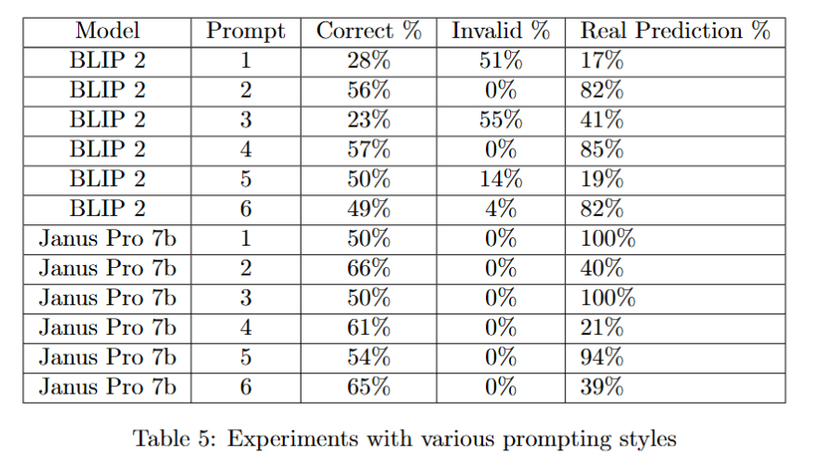
Prompt Engineering
Prompt-engineering is crucial because VLMs rely heavily on textual instructions to guide their reasoning. By carefully structuring our prompts, we can influence how the models analyze images, what features they prioritize, and how they handle uncertainty in classification

Slide 31
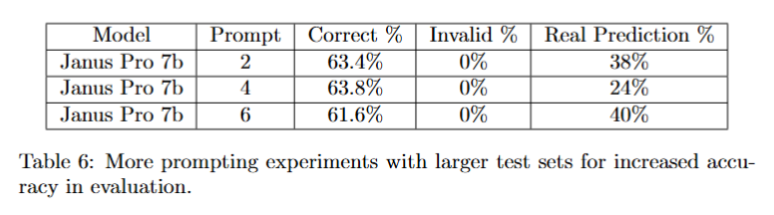
Double-checking our results…
The previous experiments were evaluated on a small subset of the ArtiFact test set (100 images) due to computational and time constraints. This means that the accuracy of our evaluation is fairly low. For this we perform a more thorough evaluation (on a test set of 500 images) of our best-performing configurations to ensure our results are sound.

Slide 32
Future Work
• Fine-Tuning the Janus Pro 7b VLM specifically on the task of SID. To achieve this with our limited hardware, employ PEFT (such as LoRA) and quantization.
• Explore the potential of a custom classifier head that receives as input the final hidden states of the VLM. These hidden states carry high level semantic information about the given image.
• Follow AIDE’s example and experiment with more hybrid approaches that combine high-level semantic features from VLMs (or other latent-spaces i.e. VAEs) and low-level features from other models in pixel-space (e.g. CNN).

Slide 33
Finally, the Chameleon Benchmark!
All models were evaluated on the highly challenging chameleon benchmark.
The best VLM configuration (Janus Pro 7b + Confidence-Based Classification Prompt) achieved 58% accuracy on the chameleon dataset. A very poor performance but still higher than both other models tested.
We hypothesize that this is because Janus can generalize better to unseen data than the other two models. Afterall, both other approaches were finetuned in a subset of the ArtiFact dataset, meaning that they learned the distributions of the generators used in that dataset, and performed better than Janus. However, in the Chameleon dataset, the data was foreign to all models, but Janus was able to generalize better and outperformed the other two models.

Slide 34
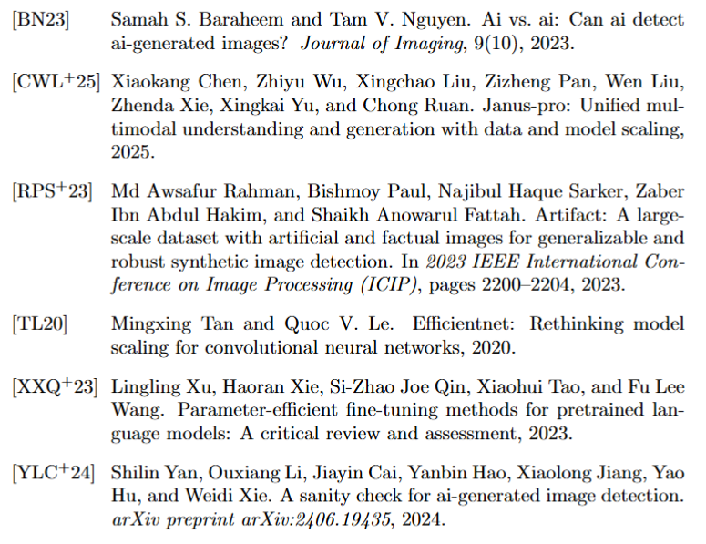
References

